Slide 1
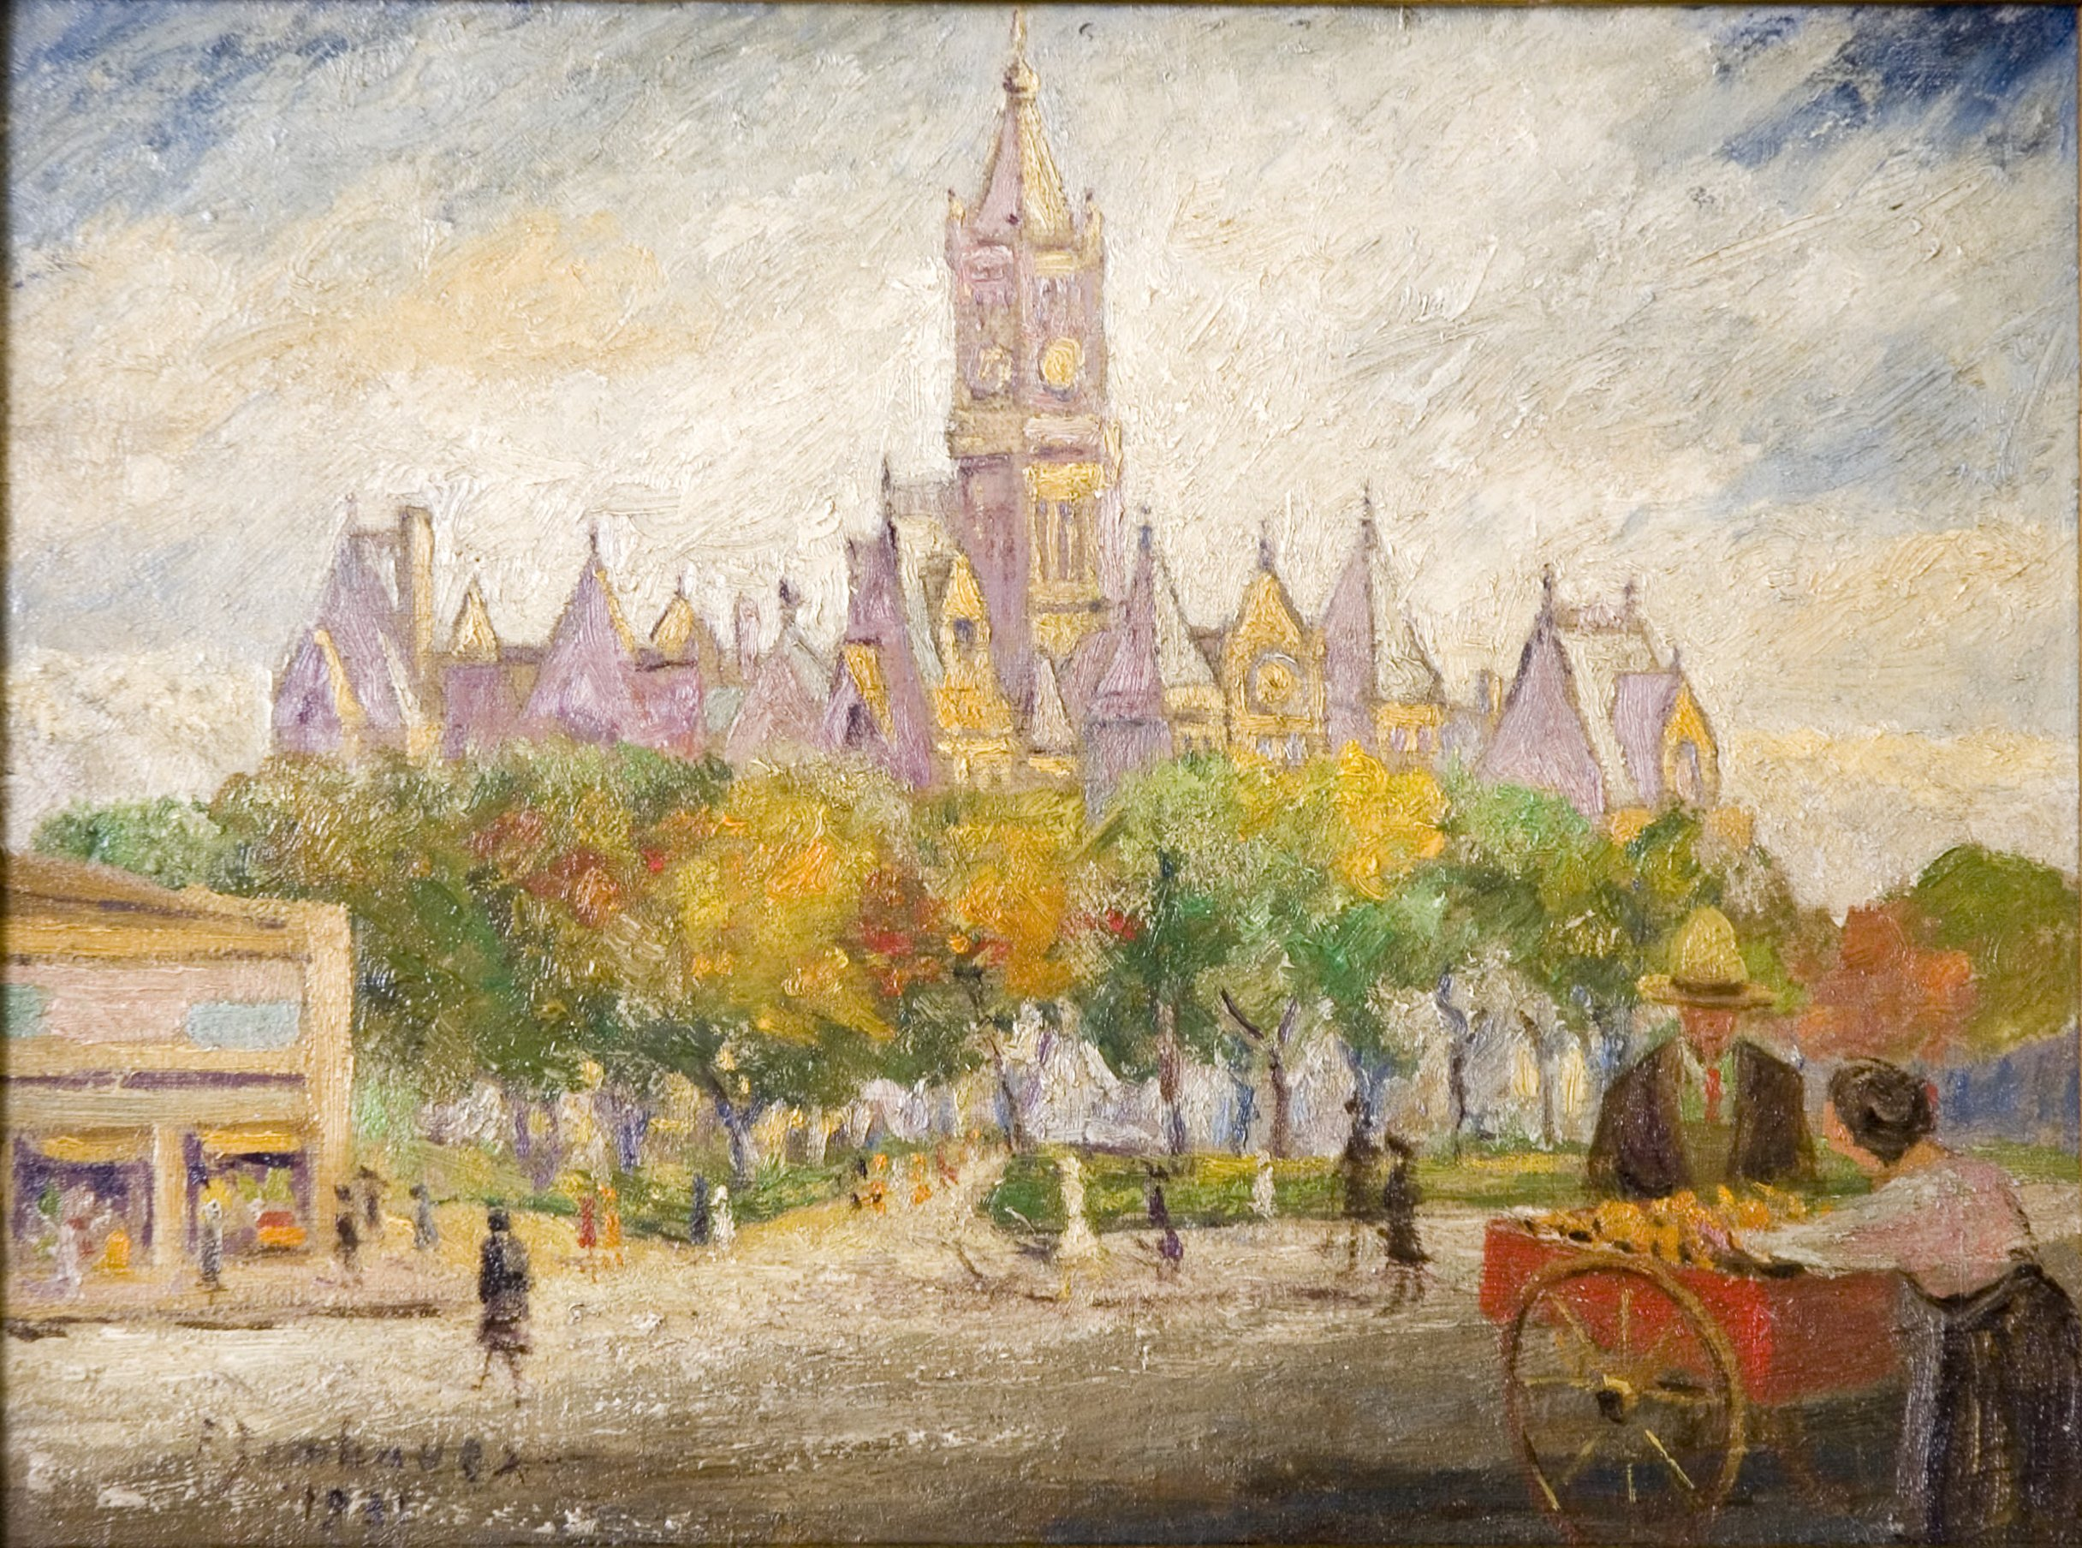
The Art of OpenRefine: Data Manipulation, Reconciliation and GREL
Meredith Hale, Metadata Librarian, University of Tennessee at Knoxville
mhale16@utk.edu, @artrunbrarian, @UTKDigCollBot
March 26, 2019, ARLIS/NA Conference, Salt Lake City
Image: Francis Zimbeaux, City and County Building, 1931, https://collections.lib.utah.edu/ark:/87278/s66w99vp

Slide 2
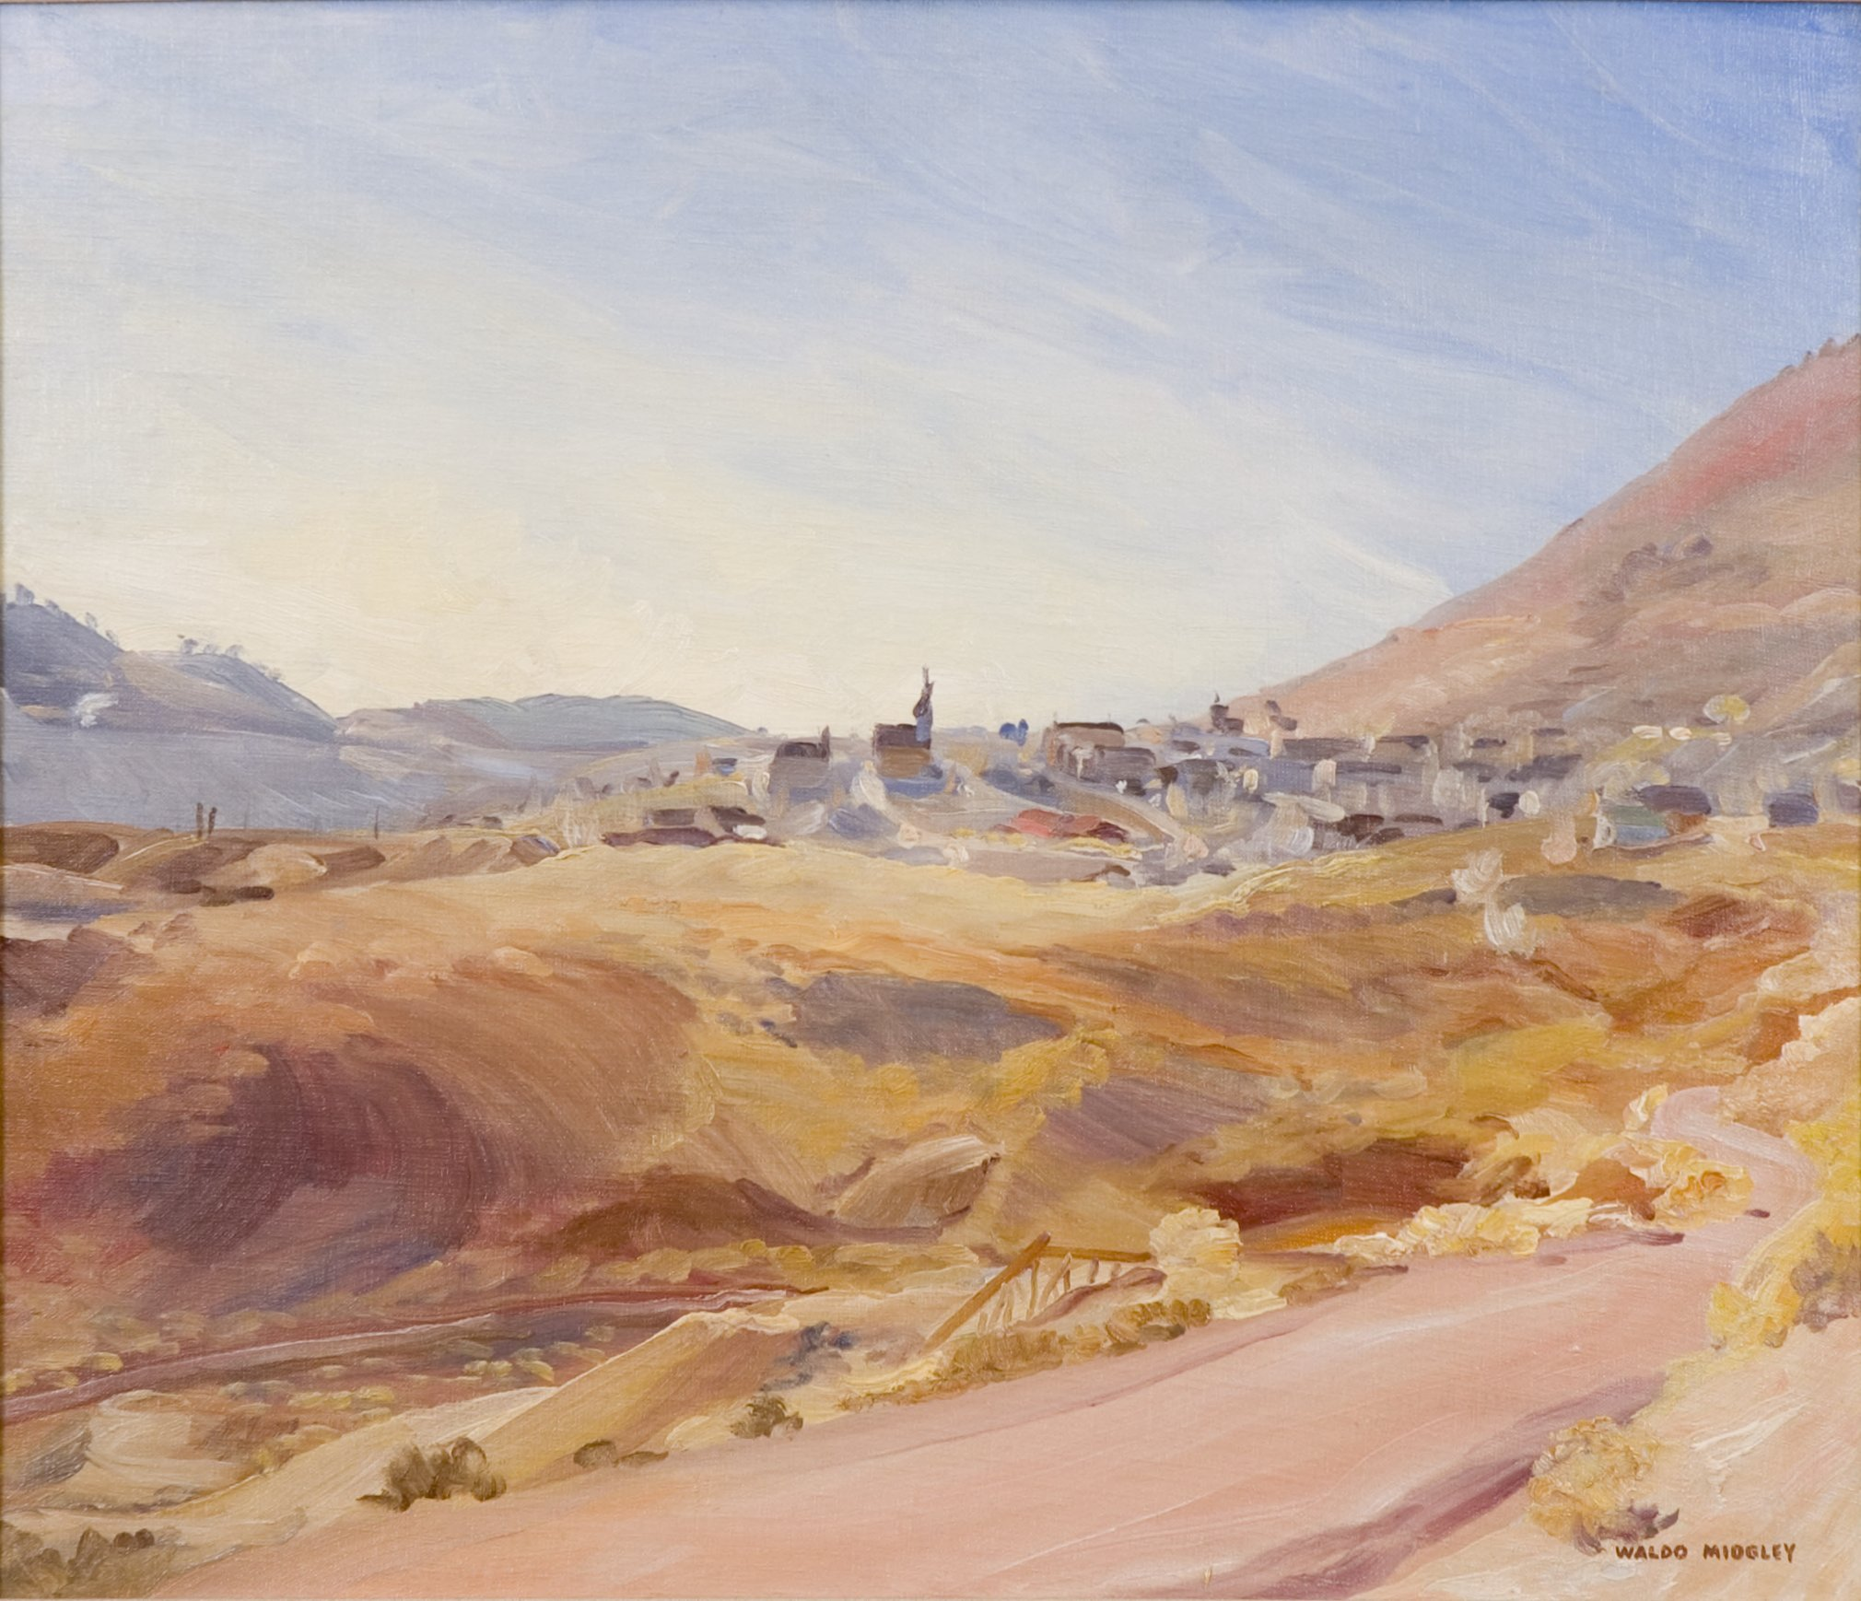
Outline
Introduction to Data Harvesting
What is OAI-PMH?
How do I use the command line?
What tools are available to harvest open data?
Remediation
What are some helpful functions built in to OpenRefine?
What is GREL?
Reconciliation
What does reconciliation mean?
What are some existing reconciliation tools?
Exporting Data
How do I export data remediated in OpenRefine?
Image: Walter Midgley, Virginia City,1936, https://collections.lib.utah.edu/ark:/87278/s6sq9043

Slide 3
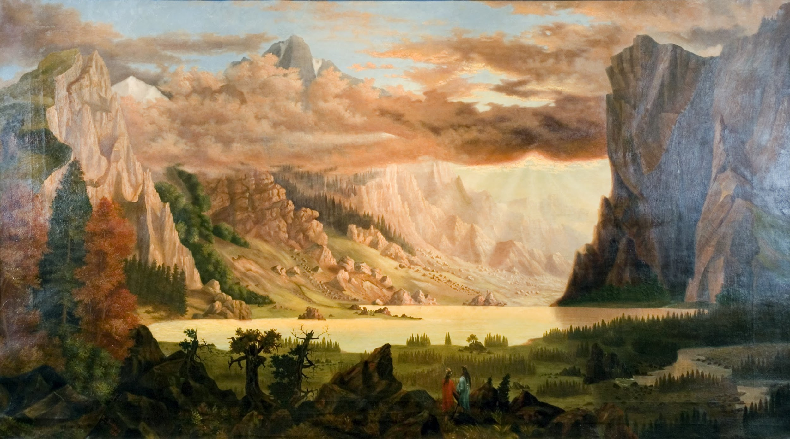
Open Archives Initiative Protocol for Metadata Harvesting (OAI-PMH)
First developed by Herbert Van de Sempel in the late 1990s
Example OAI endpoints with different functions:
ListSets - University of Tennessee
ListRecords for a single set - University of Utah
See LoC for more instructions on OAI requests
Existing OAI Harvesting Scripts
Mark Phillips’s pyoaiharvester
DLF Metadata Workshop’s harvestoai
Additional Resources
OAI-PMH Version 2.0 Specifications
Image: Reuben Kirkham, Wilds of the Wasatch, 1876, https://collections.lib.utah.edu/ark:/87278/s68915mm

Slide 4
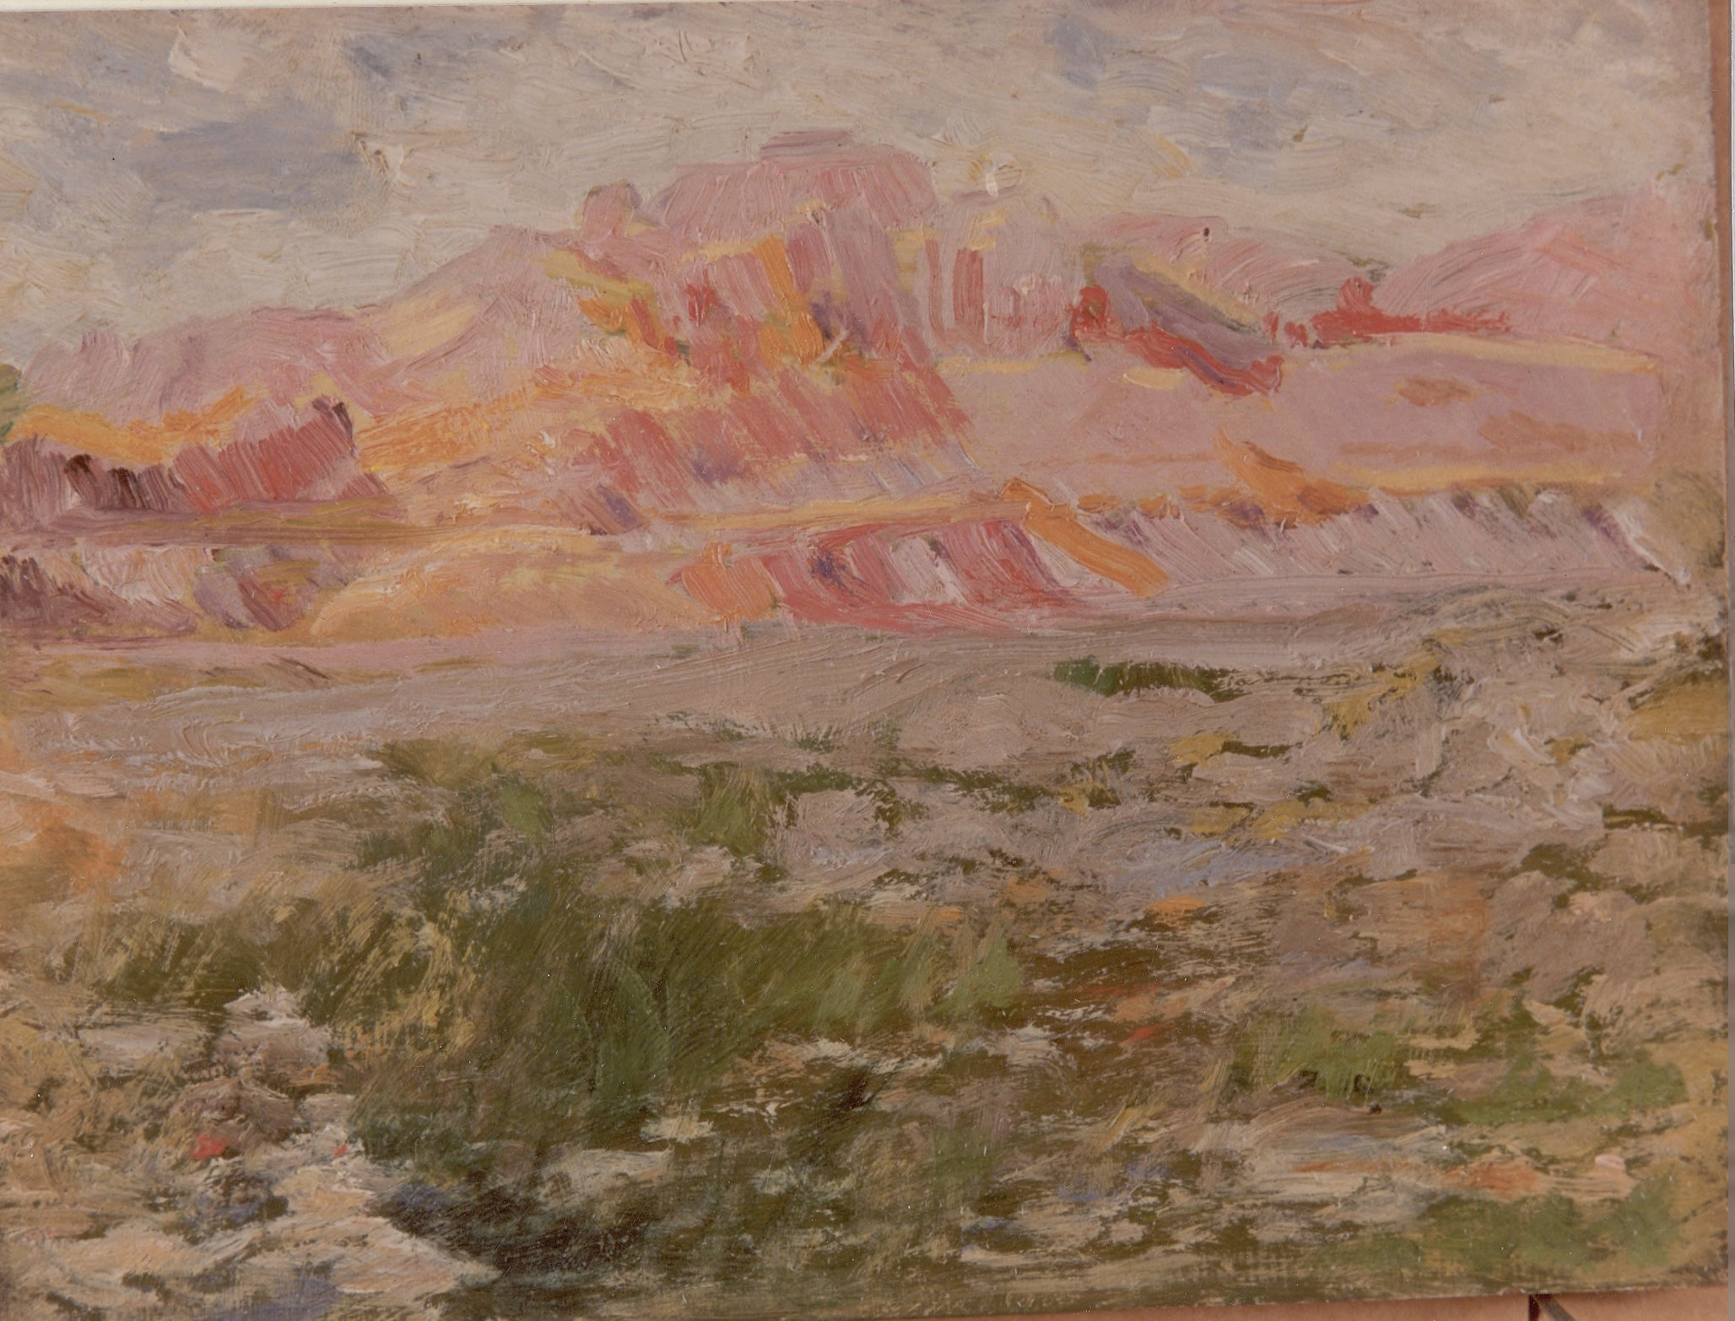
Command Line Basics
AKA CLI - Command Line Interface
Access
Mac users go to Utilities > Terminal
Windows users can type “CMD” in the start menu
Further installation instructions for Bash Shell
Basic commands
cd - Change Directory
ls - List files
pwd - Print working directory
mkdir - Make new directory
sudo - superuser do, use when a password is needed
Image: Francis Zimbeaux, Pink Butte, https://collections.lib.utah.edu/ark:/87278/s6td9wvg
Notes:
End by showing participants how to pull data using pyoaiharvester

Slide 5
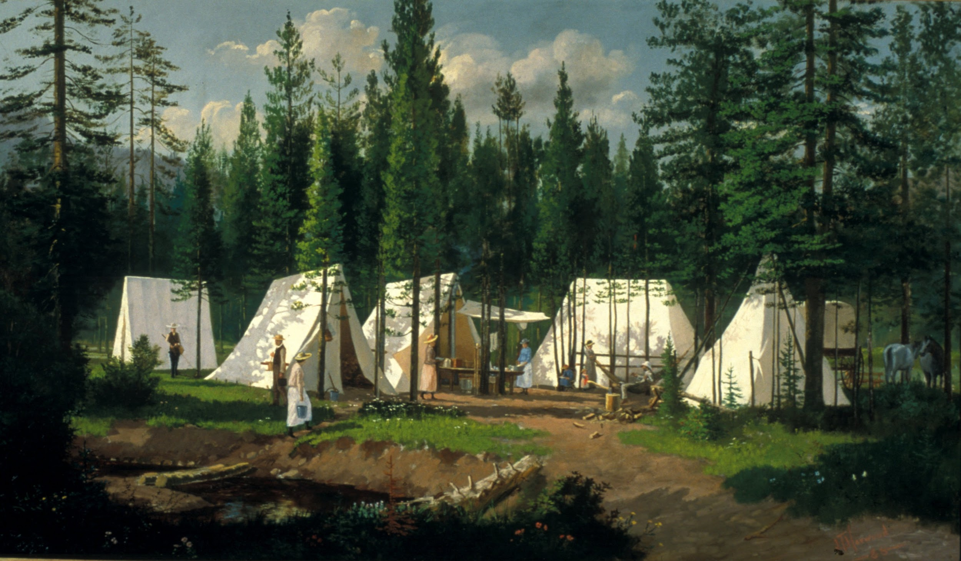
Remediation in OpenRefine
Built-in functions
Facet (by text, number, timeline)
Change data format (text, date, number)
Normalize spacing
Normalize case
Split values into different columns
Clustering to normalize values
Documentation
OpenRefine GitHub Official Documentation
OpenRefine Lessons for Digital Humanities
Image: James Taylor Harwood, Richards' Camp Holiday Park - Weber Canyon, 1888, https://collections.lib.utah.edu/ark:/87278/s6bv7g4g

Slide 6
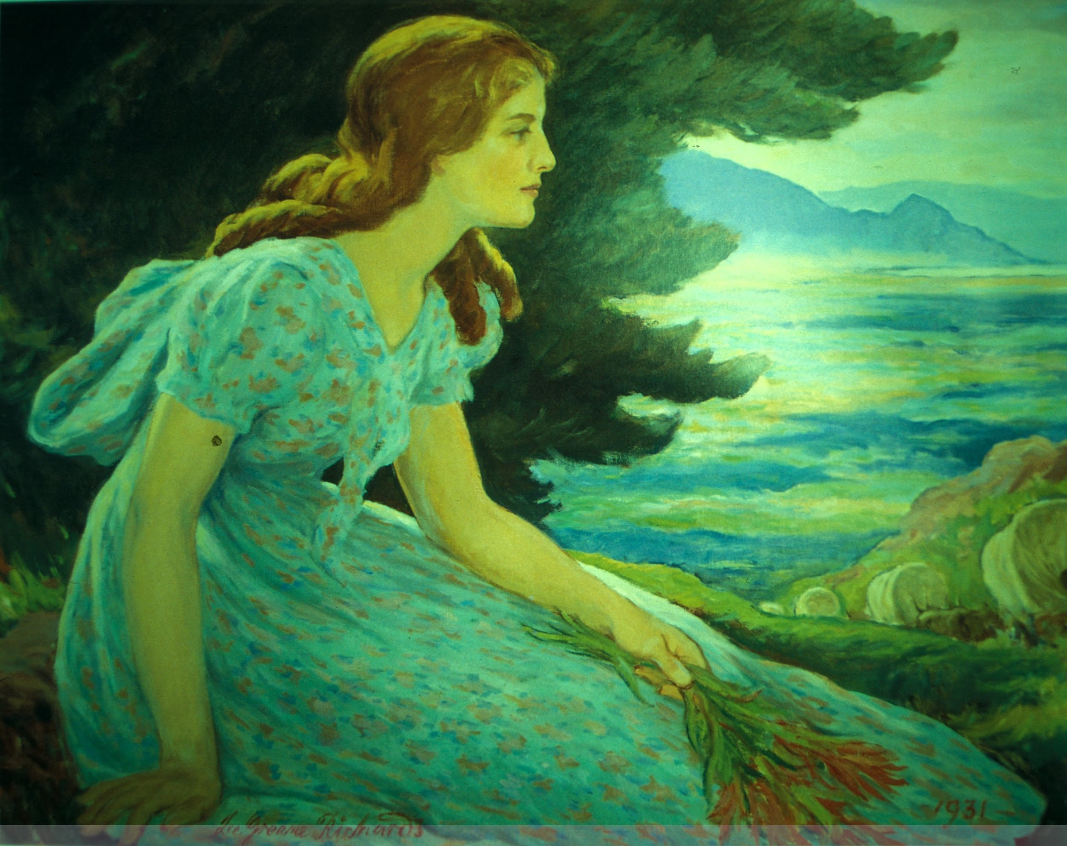
Reconciliation
What is reconciliation?
Standardizing values across a set of records in accordance with an established controlled form the value
Waterhouse, John
Waterhouse, John W.
Waterhouse, J. W.
Waterhouse, John William http://vocab.getty.edu/ulan/500027032
Portraits, American
http://id.loc.gov/authorities/subjects/sh85105188
American portraits
American portraiture
Image: Lee Greene Richards, Dreaming of Zion, https://collections.lib.utah.edu/ark:/87278/s6w37vsx

Slide 7
Reconciliation
OpenRefine Reconciliation Services
Library of Congress Authorities
Christina Harlow’s service
Michael Phillip’s service
Jeff Chiu’s service for LoC Name Authority Files
University of Tennessee, Knoxville, Heroku-hosted service
Getty Vocabularies
University of Tennessee, Knoxville Instructions
Virtual International Authority File (VIAF)
Jeff Chiu’s service
Geonames
Christina Harlow’s service
Image: Lee Greene Richards, Dreaming of Zion, https://collections.lib.utah.edu/ark:/87278/s6w37vsx

Slide 8
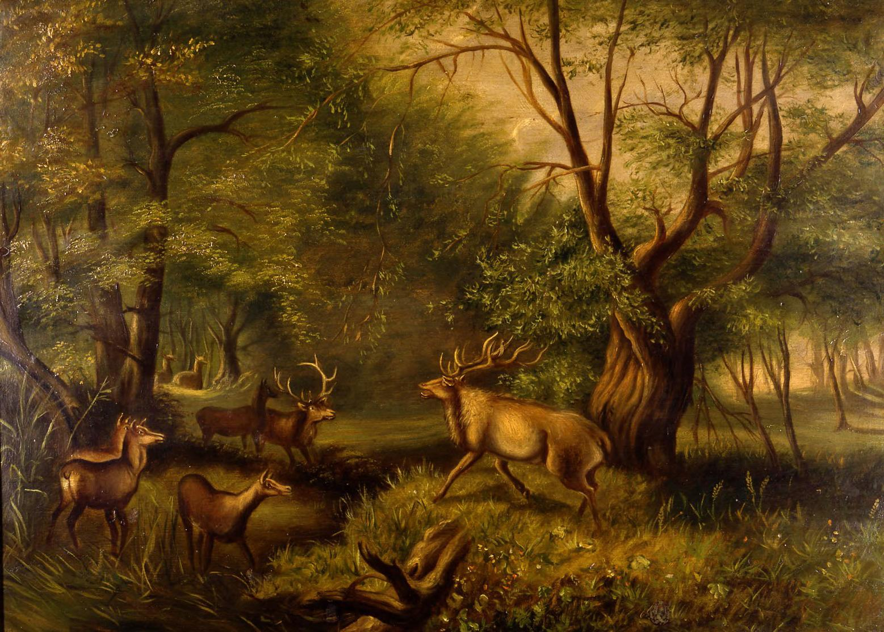
Exporting Your Data
OpenRefine offers many standard formats for exporting data
Tab-separated value
Comma-separated value
HTML table
Excel spreadsheet
ODF (OpenDocument Format) spreadsheet
Additional extensions are also available
RDF as XML
RDF as Turtle
Image: Nathanial Irving Spens, The Challenge, https://collections.lib.utah.edu/ark:/87278/s62n523r

Slide 9
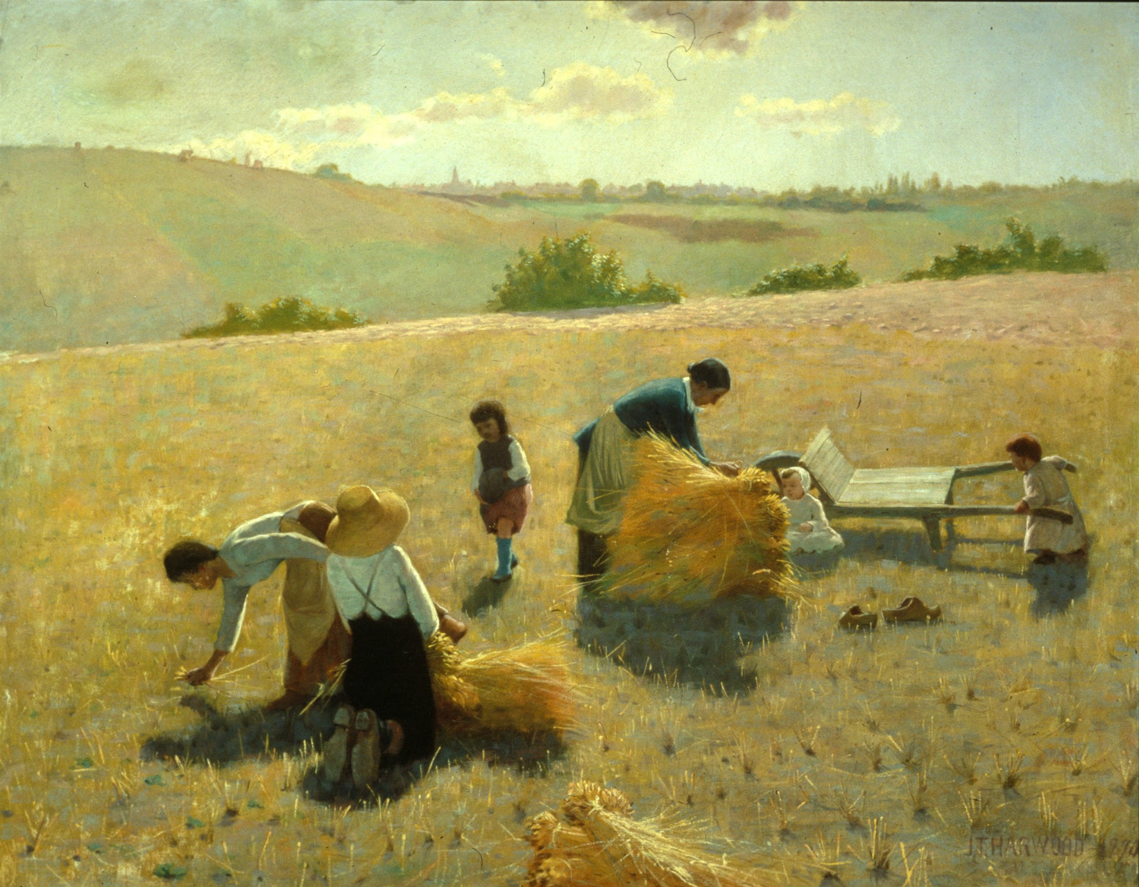
Exporting Your Data
XML Creation
Go to “Templating…”
Simple if no cells in your project are blank, but typically requires added logic
Examples of Export Code
<titleInfo><title>{{cells[‘dc:title’].value}}</title></titleInfo>
{{if(isBlank(cells['dc:creator'].value), '', '<name' + if(isBlank(cells['dc:creator_URI'].value), '', ' authority="’ + cells[‘dc:creator_auth’].value + ‘" valueURI="' + cells['dc:creator_URI'].value + '"') + '><namePart>' + cells['dc:creator'].value + '</namePart></name>')}}
Go to the UTK Metadata GitHub for more examples
Image: James Taylor Harwood, The Gleaners, 1890, https://collections.lib.utah.edu/ark:/87278/s6736qd2

Slide 10
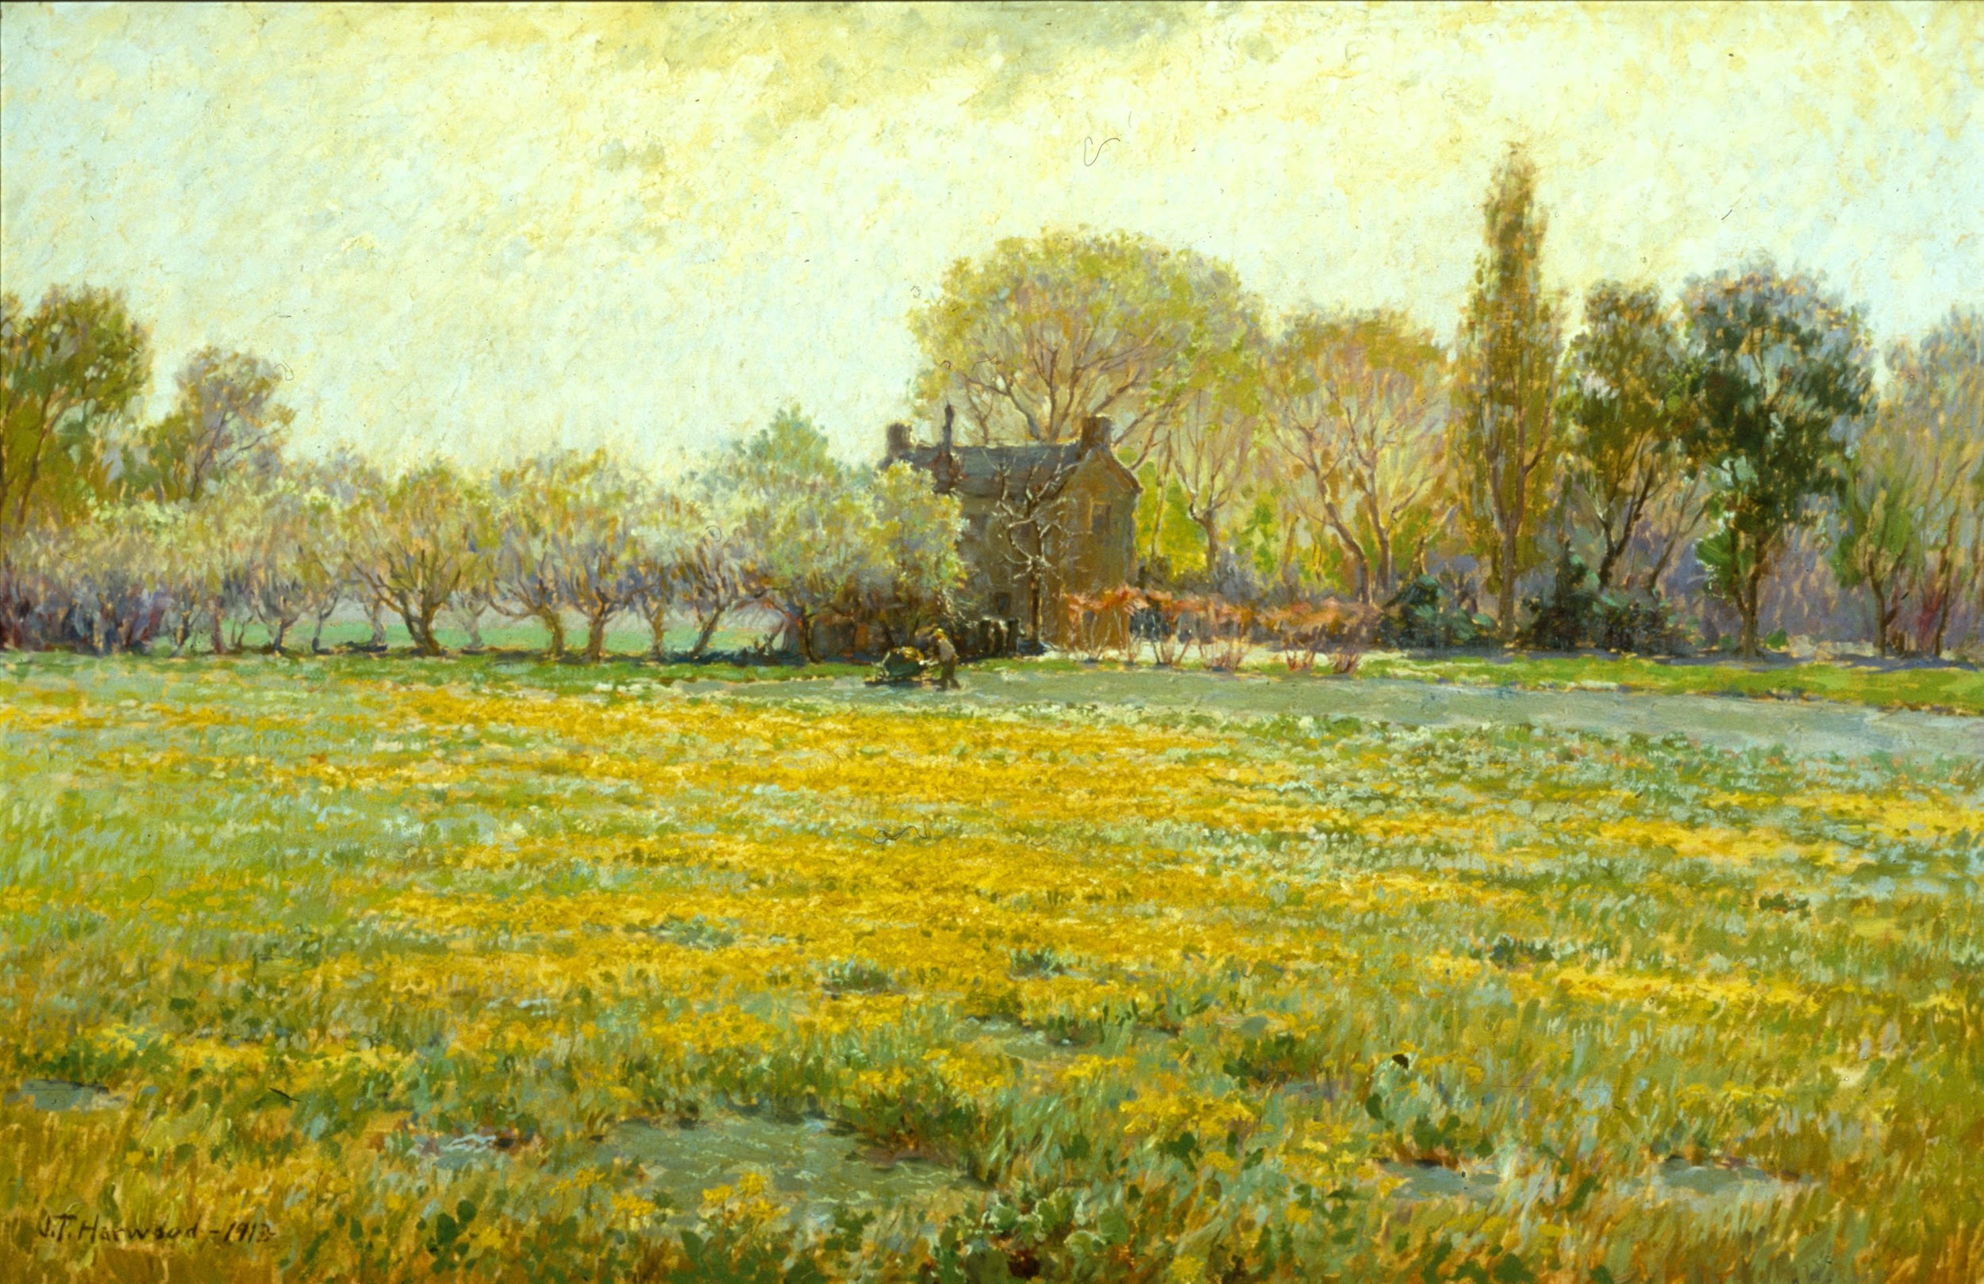
Conclusion
Do you have additional questions?
What was most useful about this workshop?
How and when do you see yourself incorporating OpenRefine into your work?
What do you see as its strengths and weaknesses?
Are there instances outside of digital collections metadata when it could be helpful?
Do you use OpenRefine in ways not covered in this workshop?
Has this workshop brought up broader issues on cataloging / metadata or open technologies you’d like to discuss?
Thanks to everyone for their participation! Thanks also to Anna Neatrour for sharing University of Utah’s OAI endpoint and to all those responsible for the development of the reconciliation services shared.
Image: James Taylor Harwood, Dandelion Fields, 1913, https://collections.lib.utah.edu/ark:/87278/s63b5zmf

